Slide 1
Log Data + GSC + Big Query
Paulo Andraus Host @ SEO Game Show / Lead Tech SEO
https://www.twitter.com/pandraus
https://www.pandraus.com/brighton

Slide 3
Why do we do this?
We have to ask ourselves:
What is the root cause?
Is this really the long-term solution?
Why/What/Who/Where/When/How/HowMuch

Slide 4
The very beginning
Before ranking
Before indexing
Before crawling

Slide 5
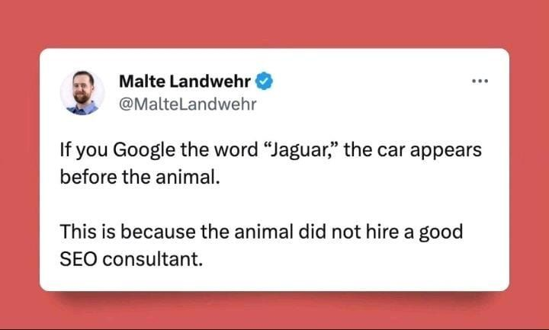

Slide 6
Before we move any further

Slide 7
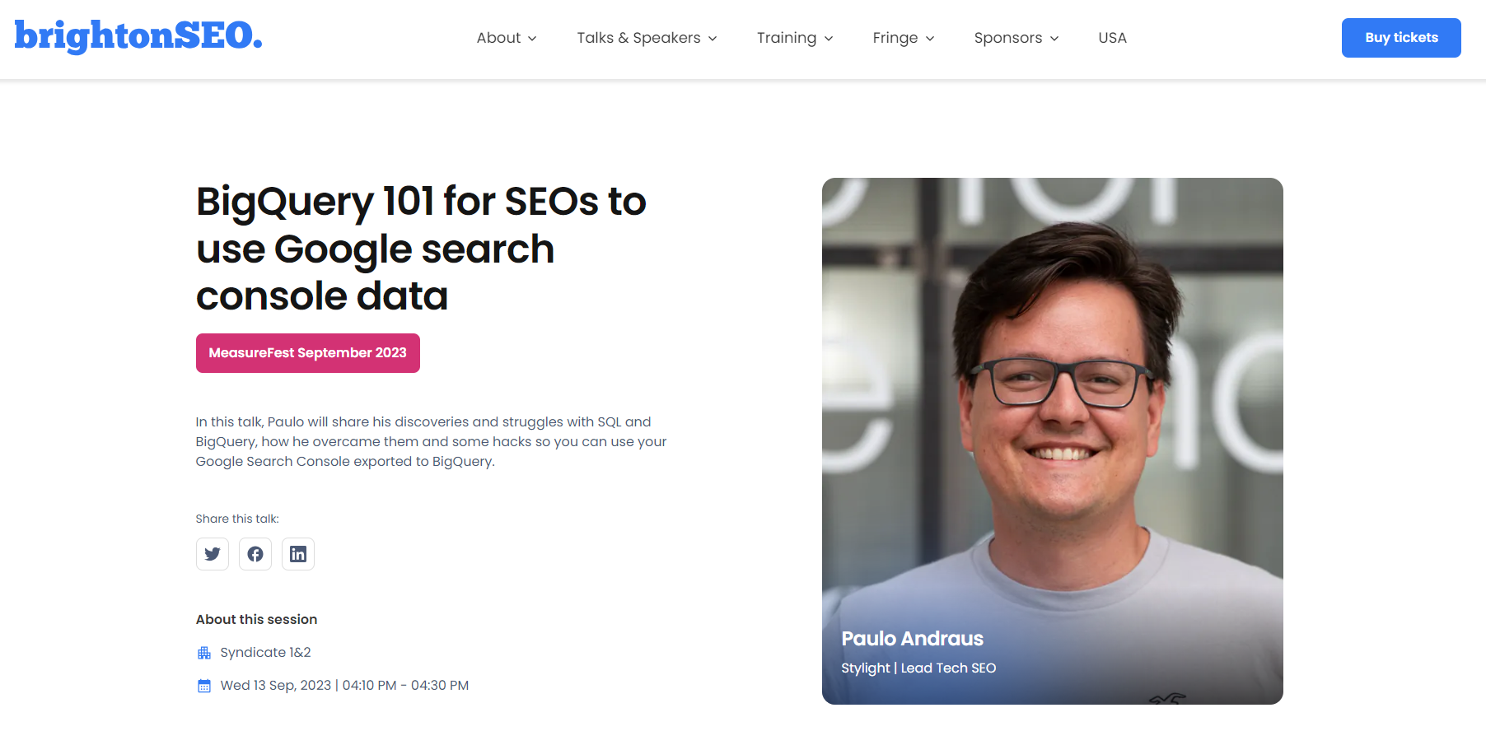
Some things don't change
Why/What/Who/Where/When/How/HowMuch

Slide 8
Paulo
Andraus
🚀Tech SEO since 2009
🛠 Agency, in house, freelancer, consultant
pandraus.com/brighton

Slide 9
Paulo
Andraus
Tech SEO since 2009
Brazil → Canada → Germany
Married, dog dad, traveler
Host of seogameshow.com
Doesn’t have a course
Doesn’t have a newsletter
Just really like SEO

Slide 10
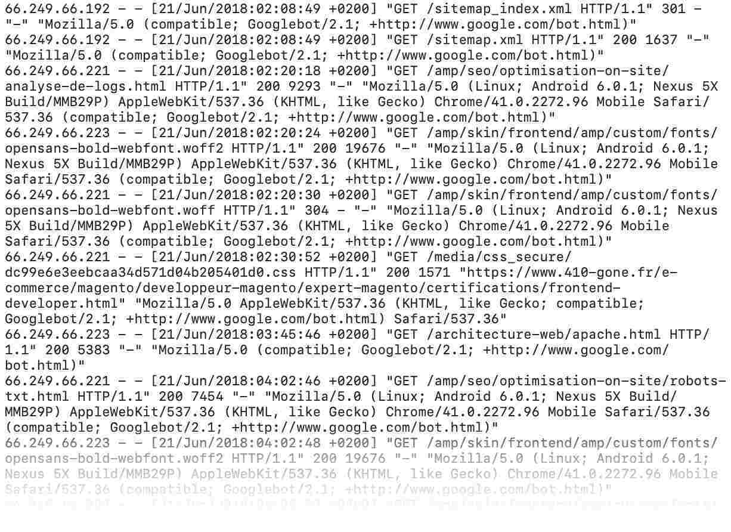
What are log files
How your server reads visitor's information
Note: access logs only
Why/What/Who/Where/When/How/HowMuch

Slide 11
Wait. Isn’t that GA?
New message from Kelvin Newman
Wasn’t this supposed to be about BigQuery? Stop stalling!
Google Analytics only shows what
the JavaScript file sent to Google
and then to you.
It is filtered, sampled, expensive and

Slide 12
not ​
owned​
by
you​

Slide 13
Where to get them
your server
Or your IT department?
Why/What/Who/Where/When/How/HowMuch

Slide 14
When to do your analysis
Check if Google visited, crawled and brought traffic to your pages
New Sections of your site
Why/What/Who/Where/When/How/HowMuch

Slide 15
When to do your analysis
Understand if old content is still visited by Google and how often
Content Pruning
Why/What/Who/Where/When/How/HowMuch

Slide 16
When to do your analysis
Did Google stop crawling that section? When did you see a decrease in traffic?
Low performance analysis
Why/What/Who/Where/When/How/HowMuch

Slide 17
When to do your analysis
You just revamped a whole section of your website and are wondering if it worked.
After your changes
Why/What/Who/Where/When/How/HowMuch

Slide 18
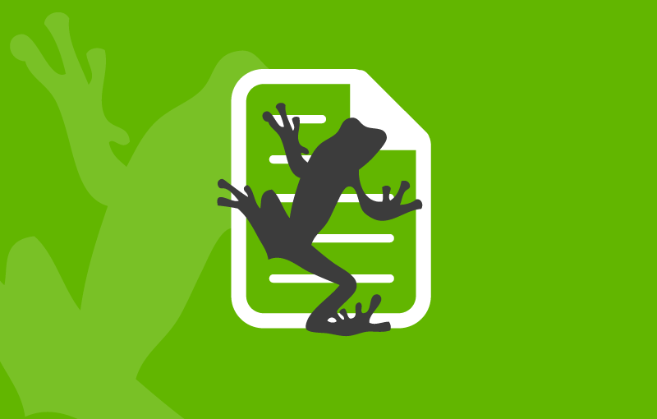
How?
Some tools to help you analyze your logs
Screaming Frog
Logflare (Cloudflare)
Content King
On Crawl
PROS
Free / £ 99 y
Unlimited logs
Connects with Screaming Frog
Allows nifty trick
CONS
Takes a lot of HD space
PROS
Free*
5.2M event logs per month
Real time
Alerts
CONS
Need to connect to Cloudflare
PROS
Connects with your Content King account
Easy to connect and get log files
On the cloud
CONS
Needs a Conductor / Content King account
PROS
Support
Dashboards and reports ready to use
On the cloud
CONS
Higher investment
No clear pricing
More log file tools here

Slide 19
But, wait [2]
New message from Kelvin Newman
Where is the BigQuery part? I’m never inviting you again.
Can’t I do all that with Google Search Console?

Slide 20
link

Slide 21
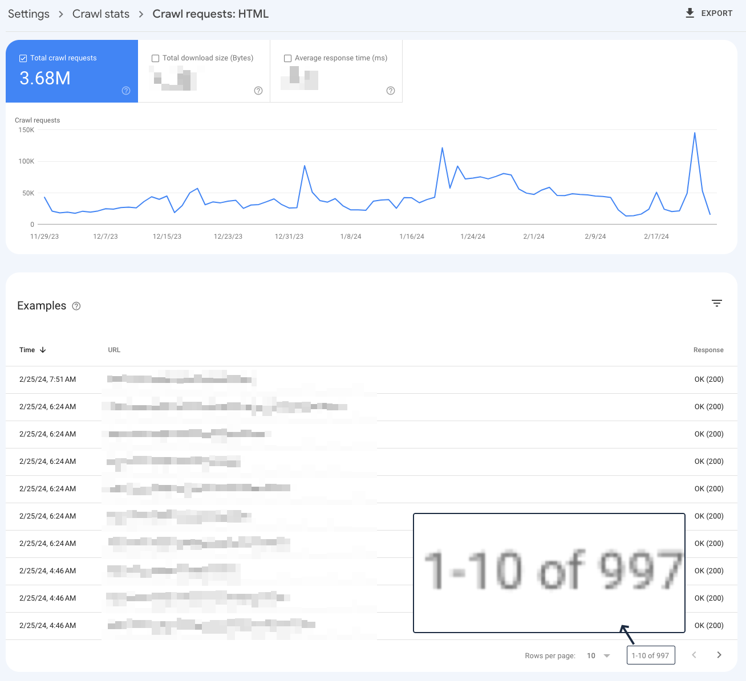
Hard to believe that Google crawled this site 3.6M times since November 2023 and only visited 997 pages…
link

Slide 22
Using your log files
New message from Kelvin Newman
Using your log files with BigQuery. Got it.

Slide 23
Log file use 1: Check your robots.txt
Learn if / how often your robots.txt had 5XX errors
What happens if your robots.txt has a 5xx error?
You get deindexed right away
Google doesn’t crawl your site for 720 minutes
It depends on your site background color
Nothing
Notes:
If Google finds a robots.txt file but can't fetch it, Google follows this behavior:
For the first 12 hours, Google stops crawling the site but keeps trying to fetch the robots.txt file.
If Google can't fetch a new version, for the next 30 days Google will use the last good version, while still trying to fetch a new version. You can see the last good version in the version history.
If the errors are still not fixed after 30 days:
If the site is generally available to Google, Google will behave as if there is no robots.txt file (but still keep checking for a new version).
If the site has general availability problems, Google will stop crawling the site, while still periodically requesting a robots.txt file.
If Google finds and can fetch a robots.txt file: Google reads the file line by line. If a line has an error or can't be parsed to a robots.txt rule, it will be skipped. If there are no valid lines in the file, Google treats this as an empty robots.txt file, which means no rules are declared for the site.
What happens when Google can't fetch or read your robots.txt
If a robots.txt file is not found for a domain or subdomain, Google assumes that it can crawl any URL within that host.

Slide 24
Bonus: What else can you do?
- Monitor for 404 errors in specific parts of your site;
- Send alerts about 500 errors to your team;
- Check if redirects stop working;
- Filter by User-Agent and check if Bing is a gentlebot;
- Look for weird HTTP status you didn’t anticipate;
- Put larger/heavier pages in a bucket
-- In that bucket, check Response Time and check if you can remove an element to make it load faster.
Notes:
- Monitor for 404 errors in specific parts of your site;
Why do I say specific parts: because log files can get heavy quick, so you might want to save them as smaller and focused files. One for your blog, one for your products, etc.
- Send alerts about 500 errors to your team;
Once you set up your recurrent log files, you can connect it to Slack or other tools to let your team know that something is wrong on their part of the website.
- Check if redirects stop working;
Do you have a list of pages you created redirects using the FROM/TO columns? I do too. You can add them to the monitoring and check if they stop working.
- Filter by User-Agent and check if Bing is a gentlebot;
Bing can be very curious about your website sometimes, you’ll see. If they go too crazy on you, you can use the robots.txt rule “crawl delay”
- Look for weird HTTP status you didn’t anticipate;
I’ve never seen a HTTP status 110 before running my first log file. Then I learned you can use whatever HTTP status you want between pages, so the back end people can create little systems that use those. Super cool.
- Put larger pages in a bucket
If you find that some pages of your site are heavier, save them like that. Then, with Screaming Frog segments, you can connect to the GSC API and see if they are getting more or less traffic after algo updates, for an example.
- In that bucket, check Response Time and check if you can remove an element to make it load faster.
Also, with INP here now, having heavier pages is probably impacting your interaction scores.
Then, after making it load faster, you can use an A/B test tool like SEOTesting.com to check if that group of pages is getting better on Google or not.
Also, you can separate them into a new bucket, call them Optimised pages, and see their specific crawling stats in the near future. Is Google crawling them more after the change?

Slide 25
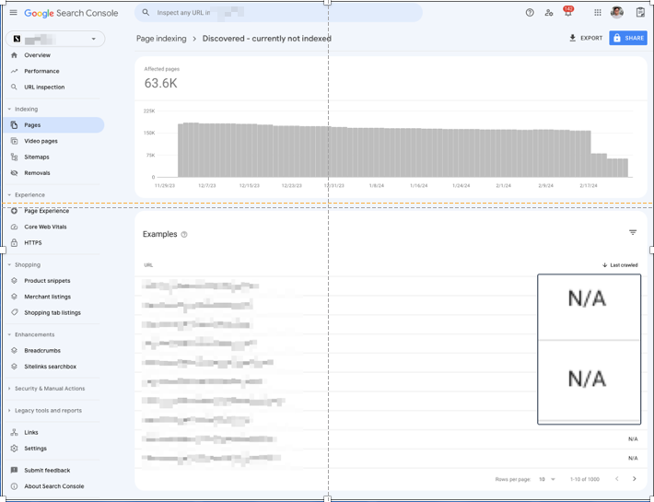
Fix Discovered – Currently Not Indexed

Slide 26
Nifty trick moment

Slide 27
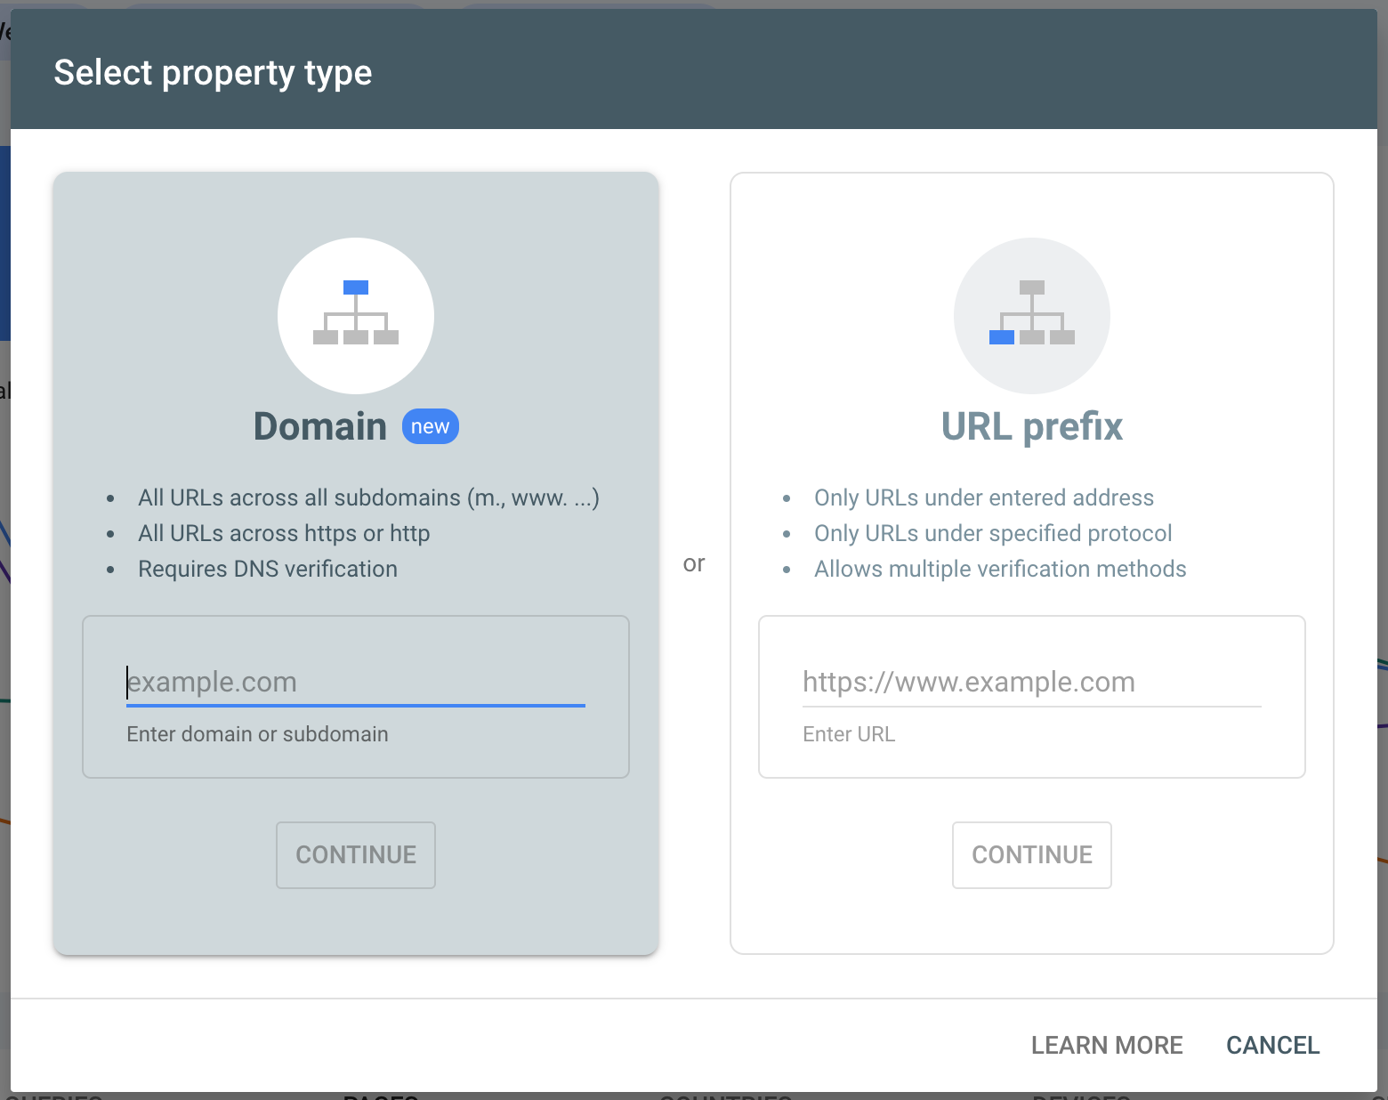
Very nifty trick: part 1
Verify your domain using the DNS verification method so you are the owner.

Slide 28
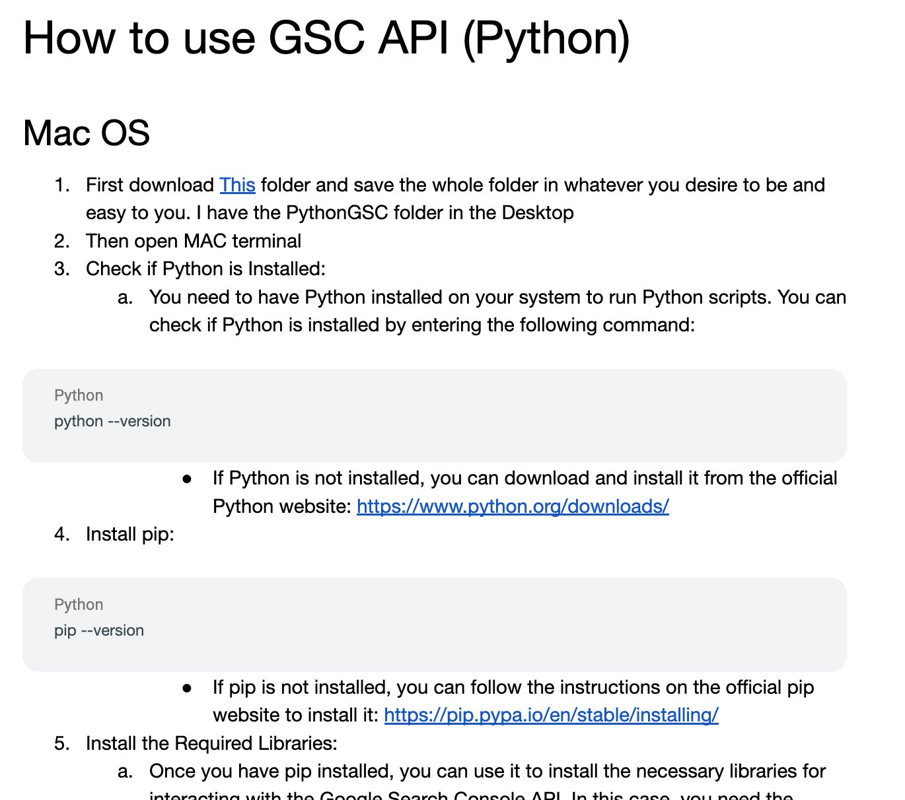
Very nifty trick: part 2
Verify your domain using the DNS verification method.
Use this python code from Saji (Tech SEO Manager @ Stylight) to verify all folders you want
Saji’s linkedin is in here as well

Slide 29
Very nifty trick: part 3
New message from Kelvin Newman
That was cool! But if you don’t start with the BigQuery section now I’ll shoot my t-shirt cannon on your face
Verify your domain using the DNS verification method.
Use this python code from Saji to verify all folders you want
Enable URL inspection and Use Multiple Properties

Slide 30
And when you connect to BigQuery
New message from Kelvin Newman
FINALLY!

Slide 31
How to connect to BigQuery
The easiest ways:
Export your BigQuery info into a Google Sheet
And then use Pivot Table
Import your Log File data into Google Drive
And then use LEFT JOIN with your GSC data being the first part of the join

Slide 32
Combine Internal Links (SF) with Crawl Rate
Crawl your site
Export Internal Links
Get your log files
See which pages are being less linked
If they are important, more internal links to them
If they are useless, redirect/content pruning project

Slide 33
BigQuery Queries per page vs crawl rate
Get your queries per page report (from my last talk)
Sort descending
JOIN LEFT with crawl rate
See if important pages are not being crawled
Seasonality? ok, let’s wait
Old content? time to revamp it

Slide 34
Discovered but not crawled reports
Export your GSC report
Check important pages
Check from log files if they are
Being crawled enough
Too heavy
Passing CWV
Have enough internal links

Slide 35
Use Screaming Frog segments + XML Sitemap creation
Based on my Linkedin post:
Create Segments using keywords you deem important
Check their Log File crawling performance (404, 200, frequency)
Based on that, create XML sitemaps for what you want to increase crawling frequency
Do that for important pages that are losing traffic!

Slide 36
Quick review

Slide 37
Quick Review
Why: it shows how Googlebot sees your site;
You own the data;
When: whenever something changes on your site;
How: tools you can use and how you can get your log files;
The difference between GSC and the rest;
Examples of what you can do with log files;
How to verify multiple GSC properties;
Connecting and using BigQuery data with 4 examples;

Slide 38
About the back pain, you ask?
Standing desk for the rescue!

Slide 39
obrigado

